Slide 1
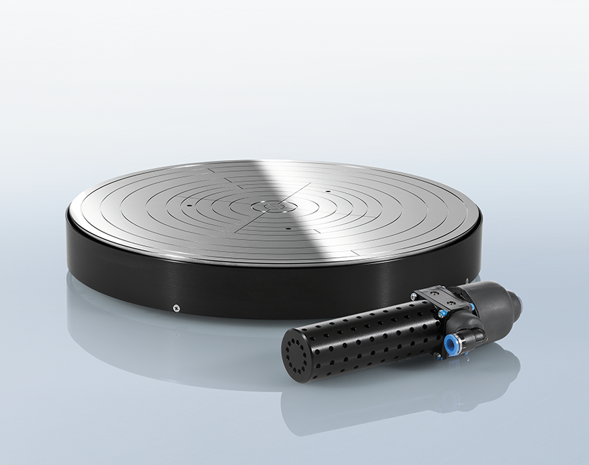

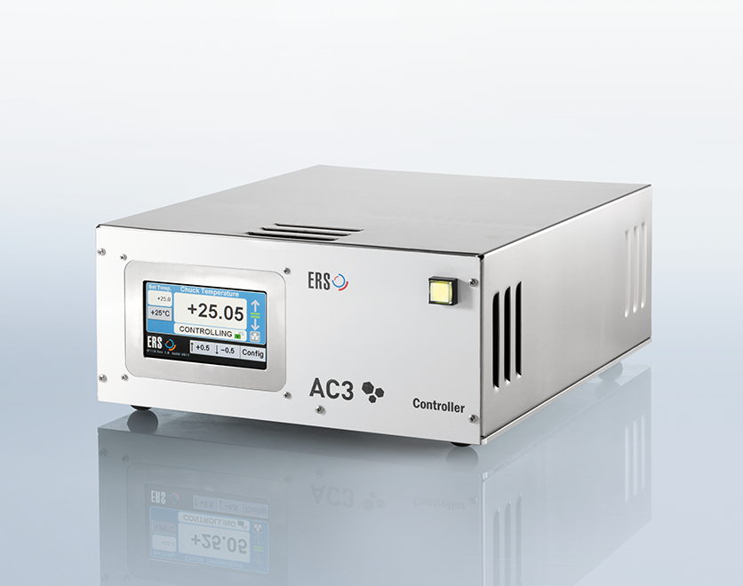
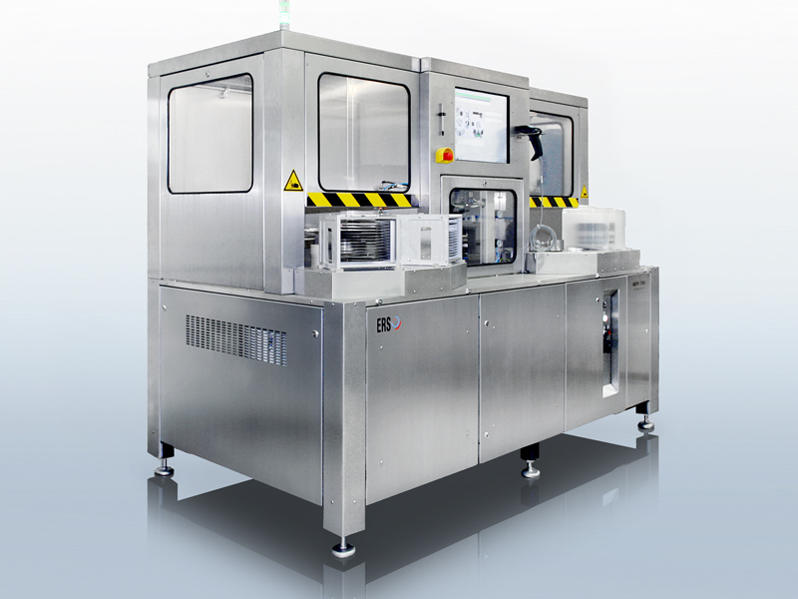
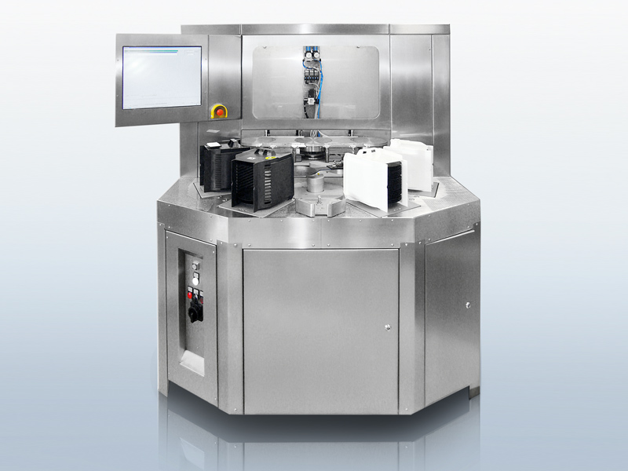
Innovation is in our lifeblood

Slide 2

Endtest Project Update 23.5.2019
By Austin Ibele

Slide 3
Agenda
Overview of Projects
Project Status
Future

Slide 4
Overview of Reccomendations
Documentation
Computer Data Entry NEW (90%)
Computer Defect Tracking NEW (75 %)
Document Processes (50%)
Sensarray Text Recognition NEW (10%)
Quality Assurance
Check Labels with Image Recognition NEW (75%)
Optimization
Electric screwdriver (management decision)
Automation
“Doc Generator V2”/XLS data validation (complete)
Pipe Auftrags to Seriennummern XLS (90%)
Automate temperature uniformity and heating/cooling curves (not started because Paddy’s workload)
Label printer (X canceled – UL concerns)
Automate temperature display calibration (Software department has same idea for HTU chucks)
Process Change
New controllers for Chuck department and more intensive testing (management decision)
Final visual check/signoff (management decision)
Separate person for packing/shipping/system inspection (management decision)

Slide 5
Documentation-Related Suggestions

Slide 6
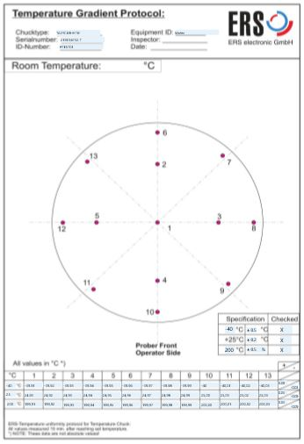
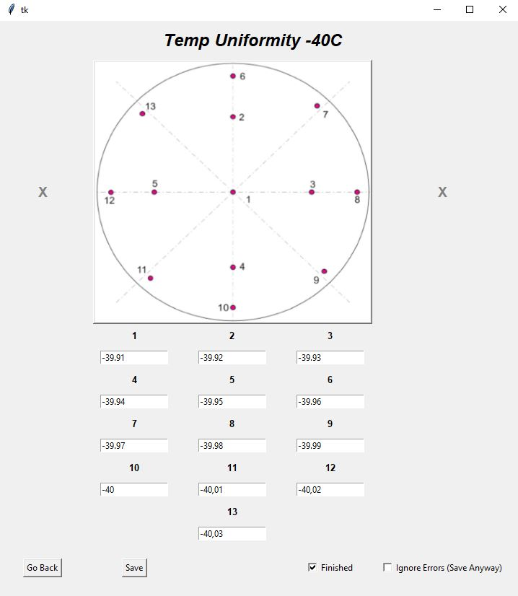
Computer Data Entry
What:
Graphical Application for Temperature/Planarity/PT100 tests
Identifies out-of-spec values
Computer generates test protocols
Saves all data in spreadsheets
Makes later data analysis possible
Work Remaining:
Allow for multiple users at once
Save both in-spec and out-of-spec data
Test in variety of conditions
Translate
Document Code and Implement

Slide 7
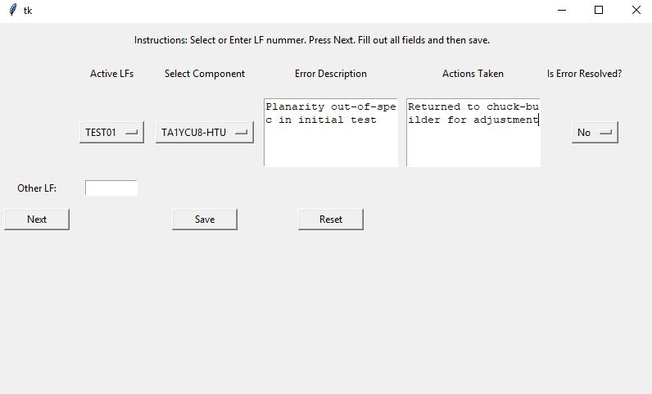
Computer Defect Tracking
What:
Graphical Application for documenting quality issues discovered in production
Document and describe defect by both LF and component
Records „user“ so reports can be tracked to employee
Work Remaining:
Do we want to do this?
If so, brainstorm additional functionality that we want
Build functionality
How will Manfred track?
Document and implement

Slide 8
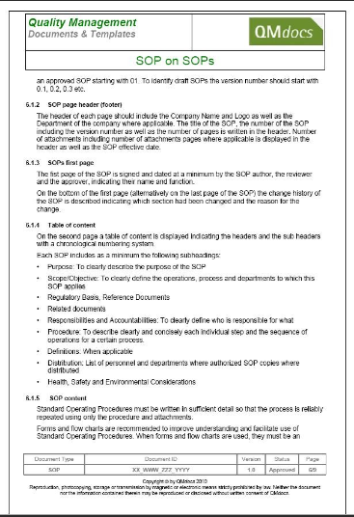
Document Process
What:
Create documentation describing Endtest
Create procedures documents
Assist others to perform Endtest duties
Work Remaining:
For common procedures complete but missing fine details
Documentation for less common procedures missing
Needs to be translated
Better to be completed by someone else (e.g. Matthias)

Slide 9
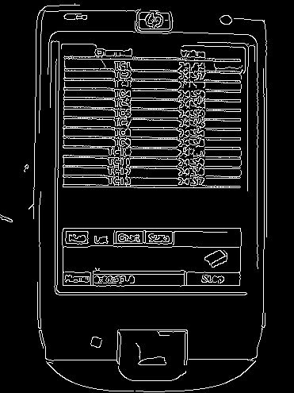
Sensarray Text Recognition
What:
Read Sensarray Display using HD camera and text recognition
Automate collection of uniformity data
Have true data instead of only a snapshot
Work Remaining:
Reliably identify text locations (paint white?)
Extract text and test accuracy
Integrate into Data Collection Program

Slide 10
Quality-Assurance Suggestions

Slide 11
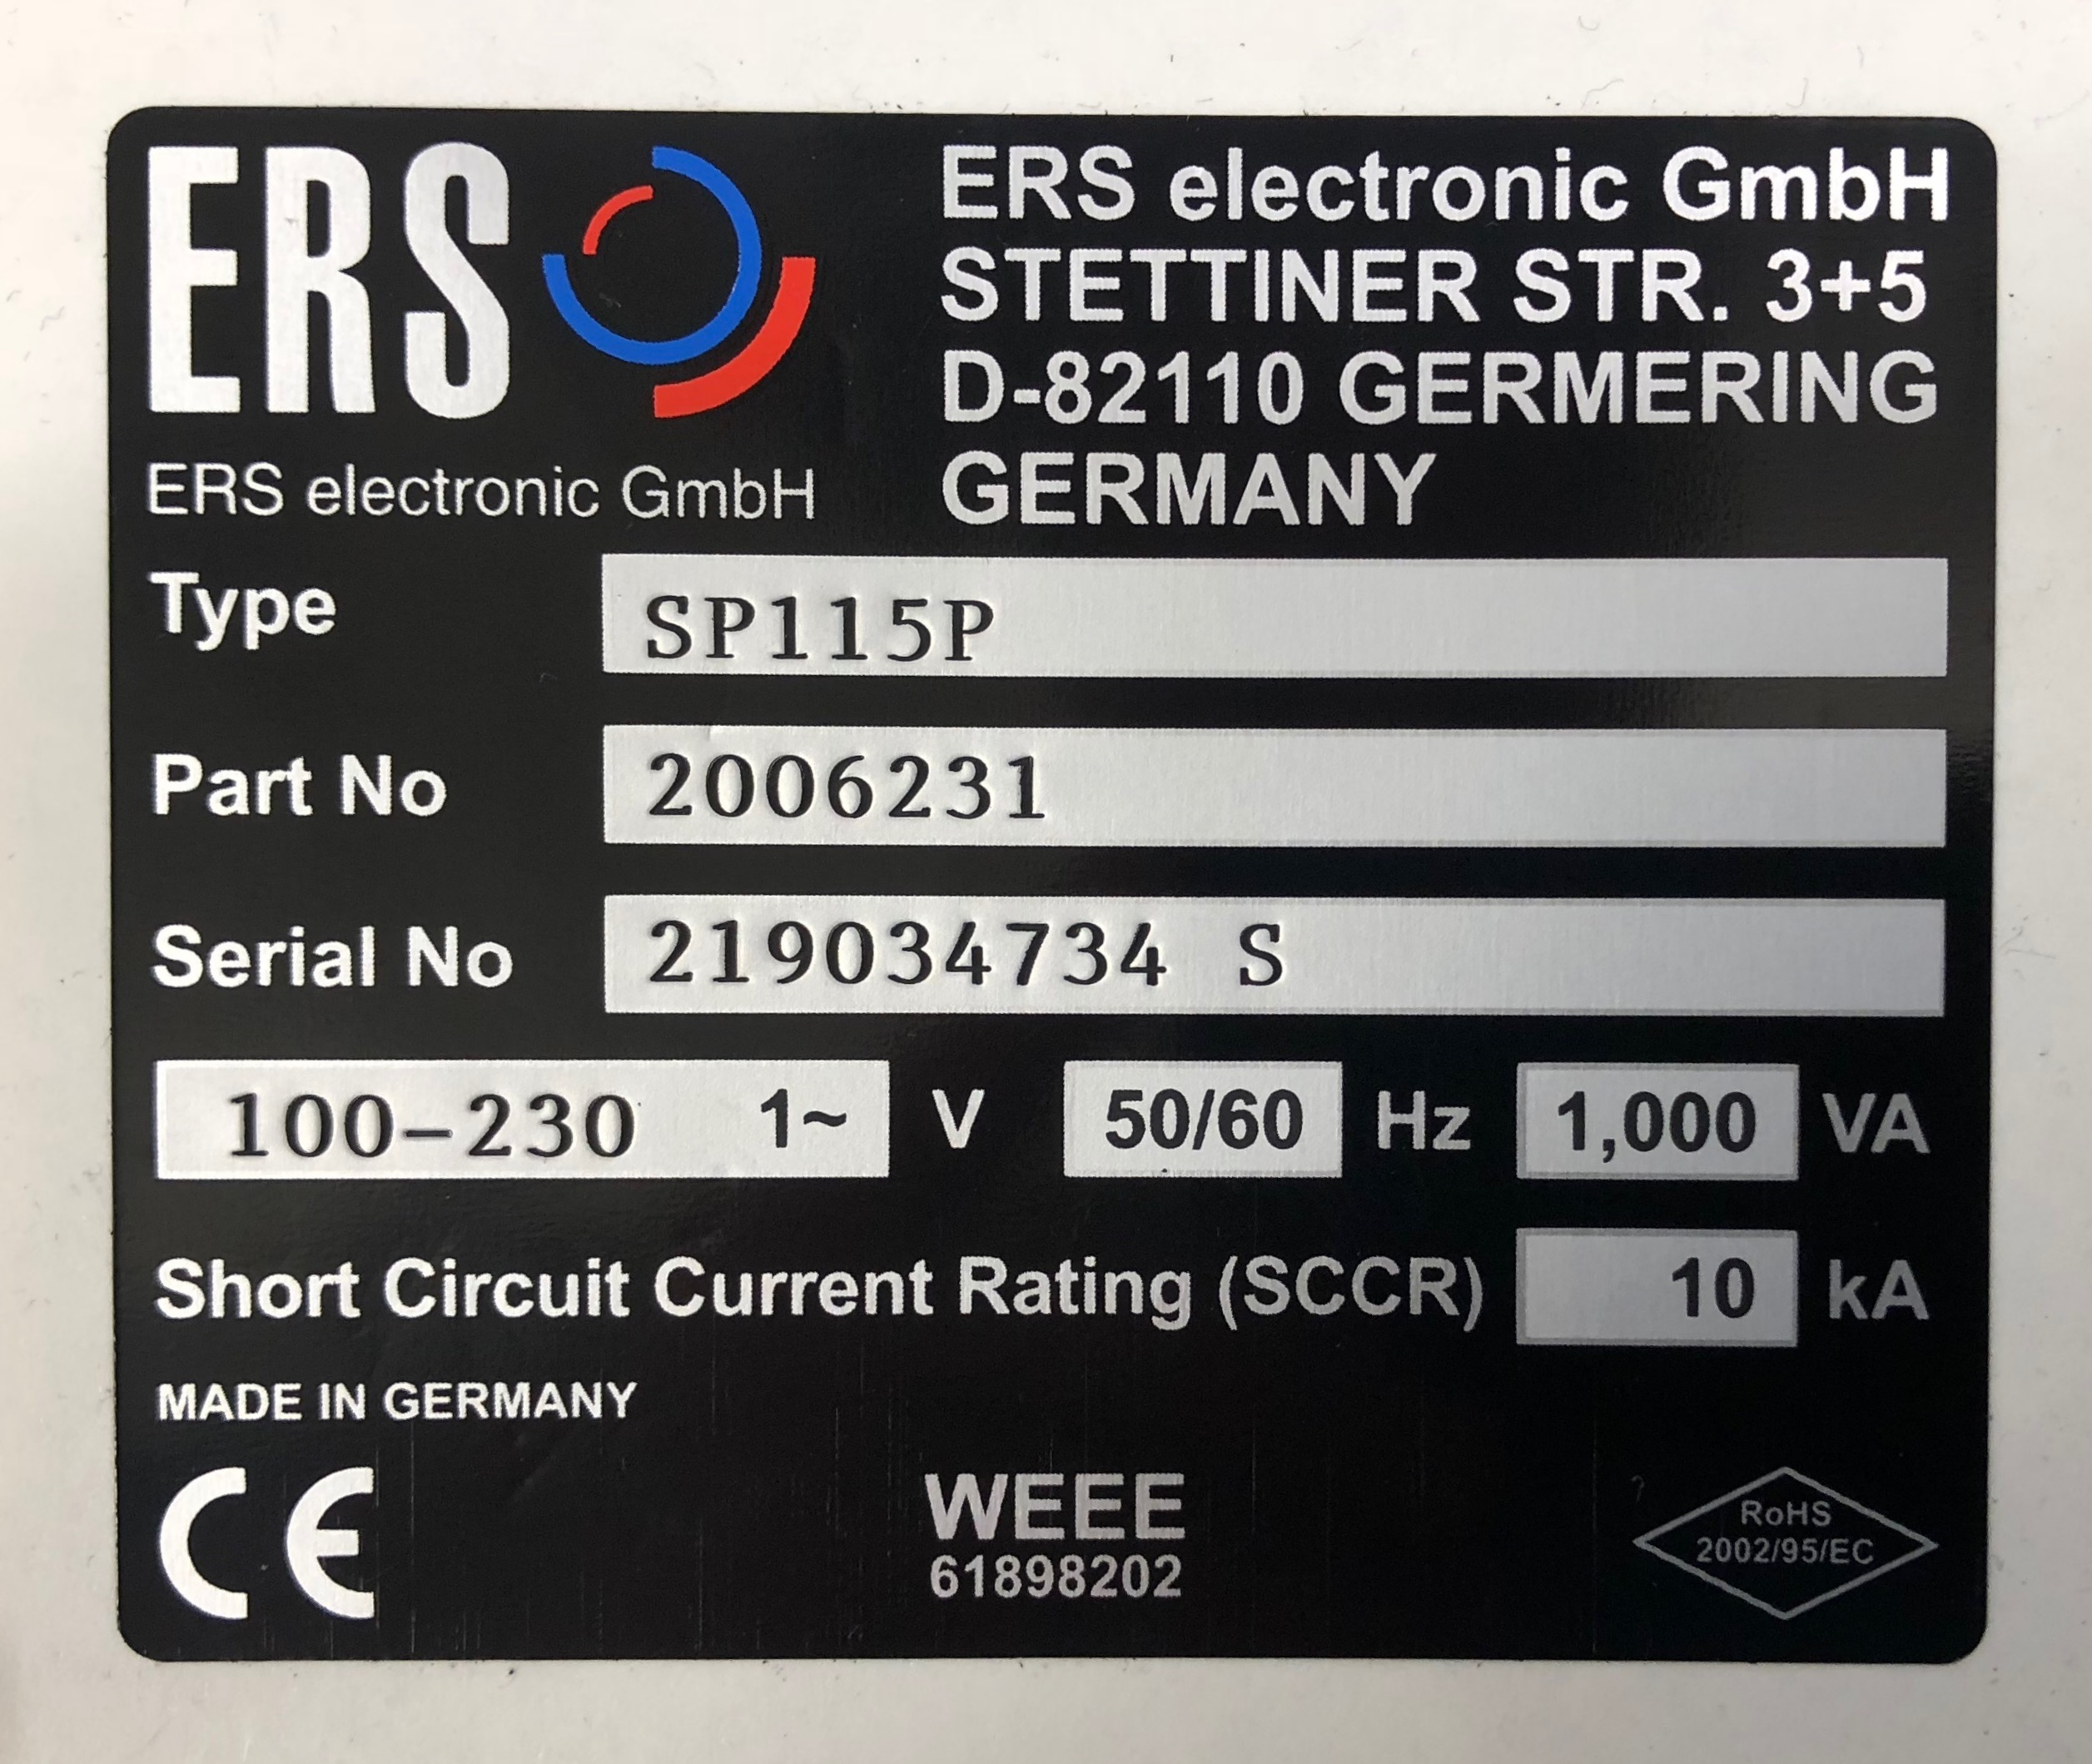

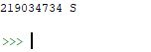
Label Verification with Text Recognition
What:
Read labels using camera and text recognition
Check accuracy of Serial Number
Build into Data Entry Program? Tablet would be ideal..
Work Remaining:
Sucessful recognition complete
Test Accuracy from different perspectives/light conditions
Notes:
https://www.amazon.com/Windows-Fusion5-Ultra-Design-Tablet/dp/B00YCX7SGU/ref=sr_1_3?keywords=windows+10+tablet&qid=1552466918&s=electronics&sr=1-3

Slide 12
Optimization-Related Suggestions

Slide 13
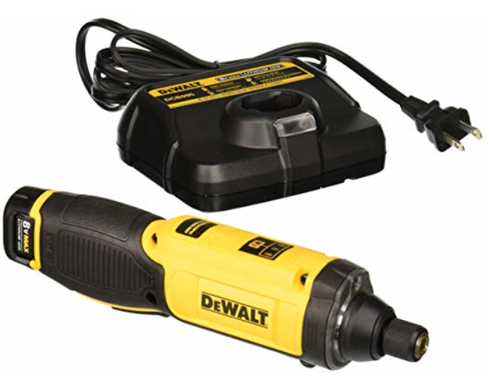
Electric Screwdriver
What:
Electric screwdriver to save time
Cheap and easy to implement
Discussed Before
Work Remaining:
Management Decision

Slide 14
Automation-Related Suggestions

Slide 15
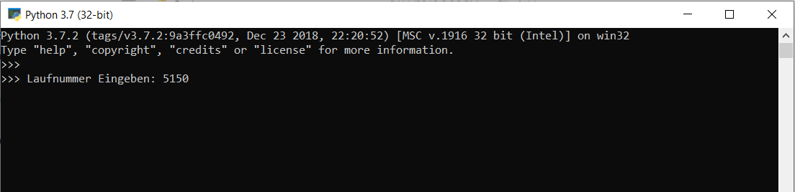
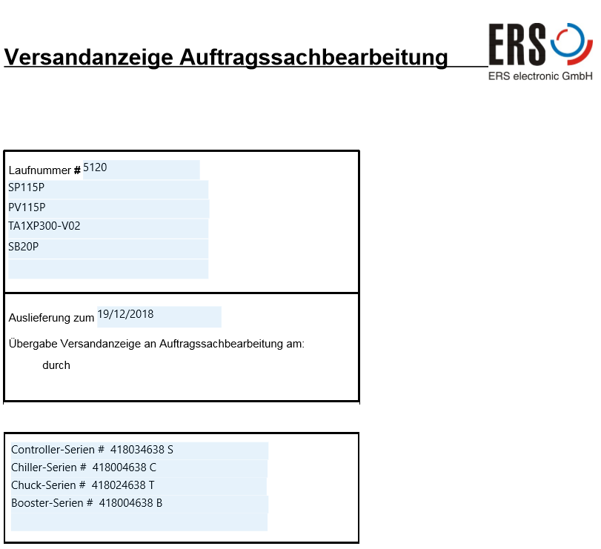
”Doc Generator V2”/XLS data validation
What:
Further improve accuracy/time savings of „Endtest Document Generator“ tool
Merge many PDFs into a single document for eaiser printing
Create macros in „Seriennummern“ spreadsheet to prevent entry
of incorrect information
Incorporated MPI order # into documents
Complete

Slide 16
Pipe Auftraegslist to Seriernnummern XLS
What:
Take data from Auftraegslist (assumed to be accurate) and move to location that Nuhan‘s computer can acess
Import data into Seriernnummern XLS that Nuhan uses
Further reduce innacurate manual data inputs
Save time
Work Remaining:
Build VBA code to import data
OR build VBA code to directly copy from Auftraegslist
Set up Cron task on manager computer to run automatically

Slide 17
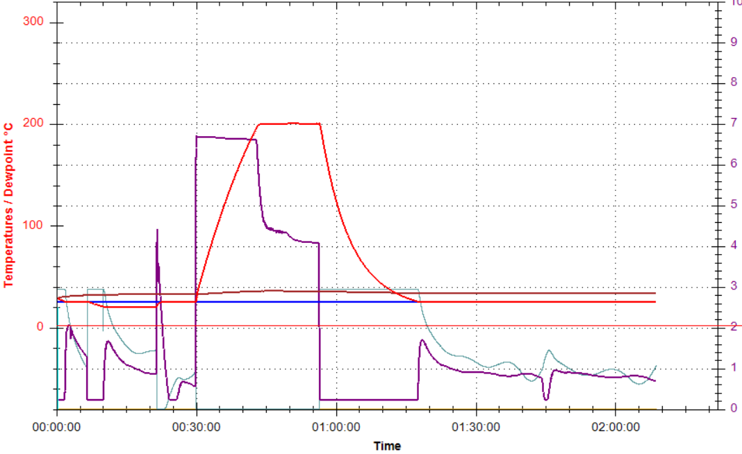
Automate temperature uniformity and heating/cooling curves
What:
Automate determination of heating/cooling time and uniformity profile
Paddy will create new option in software to run heating/cooling and
steps together
New computer program will analyze Sensarray data and determine
heating/cooling time and temperature uniformity
Work Remaining:
Not started
Paddy too busy
Reading Sensarray data with text recognition is a pre-requesite

Slide 18
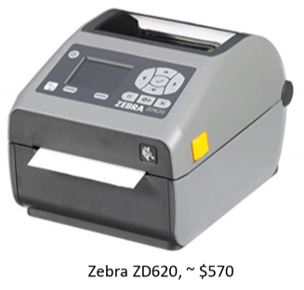
Label Printer
What:
Accurately make labels with a label printer
Print on high temperature labels with programmable thermal transfer printer
Canceled
Additional production steps needed to keep UL certification

Slide 19
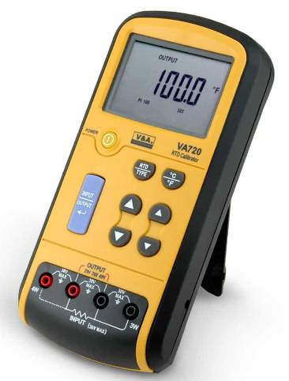
Automate Temperature Display Calibration
What:
Create new test program to guide/perform PT100 calibration protocol
Adjusts calibration curve by comparing to simulation data
Software department has the same idea
Work Remaining:
Software department may build for HTU chucks if they think its worth it
If they do, can be adapted for all PT100 calibration in production

Slide 20
Process Change-Related Suggestions

Slide 21
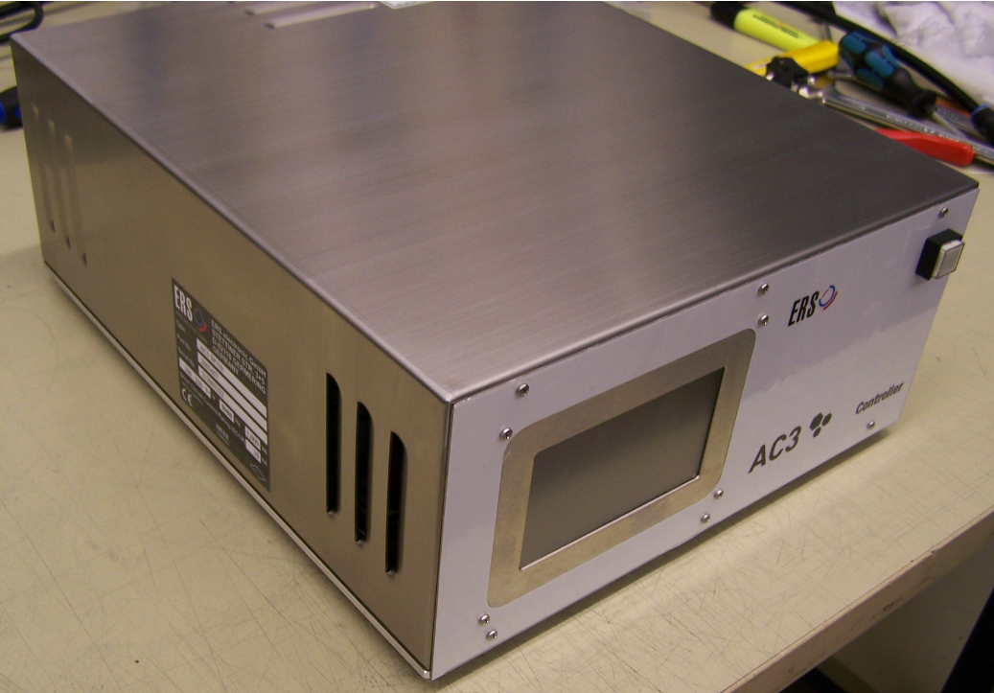
New controllers for Chuck department and more intensive testing
What:
Find controlling problems earlier with new controllers and different tests in Chuck Department
Replace uberschwing test with heating to 50C, headting to 80C and controlling (more accurate at detecting bad PT100 placement -- reccomended by Paddy)
Work Remaining:
Management decision
SP110 Controller

Slide 22
Final Visual Check/Sign-off
What:
Have another employee visually inspect/sign-off on system
Add to duties of upstairs/Lager worker (better if they are disconnected from production process)
Perform after testing and prior to packaging
Work Remaining:
Management decision/additional employee?

Slide 23
Separate person for preparation/packing/shipping
What:
Similar to previous reccomendation but with additional duties
Another employee focuses on preparation of materials, visual inspection, packing, shipping
Separate from test duties of Nuhan
Work Remaining:
Management decision/additional employee

Slide 24

Contact us
Interested in learning more? Contact us:
E-Mail: info@ers-gmbh.de
Web site: www.ers-gmbh.com
Telephone: +49 8989 4132-0
Follow us on social media:
Twitter: @ers_gmbh
LinkedIn: https://de.linkedin.com/company/ers-electronic-gmbh
Press contact: Miguel Resendiz
E-Mail: m.resendiz@ers-gmbh.de
Telephone/Mobile: +49 8989 4132-143

Slide 25

Thank You

